Slide 1

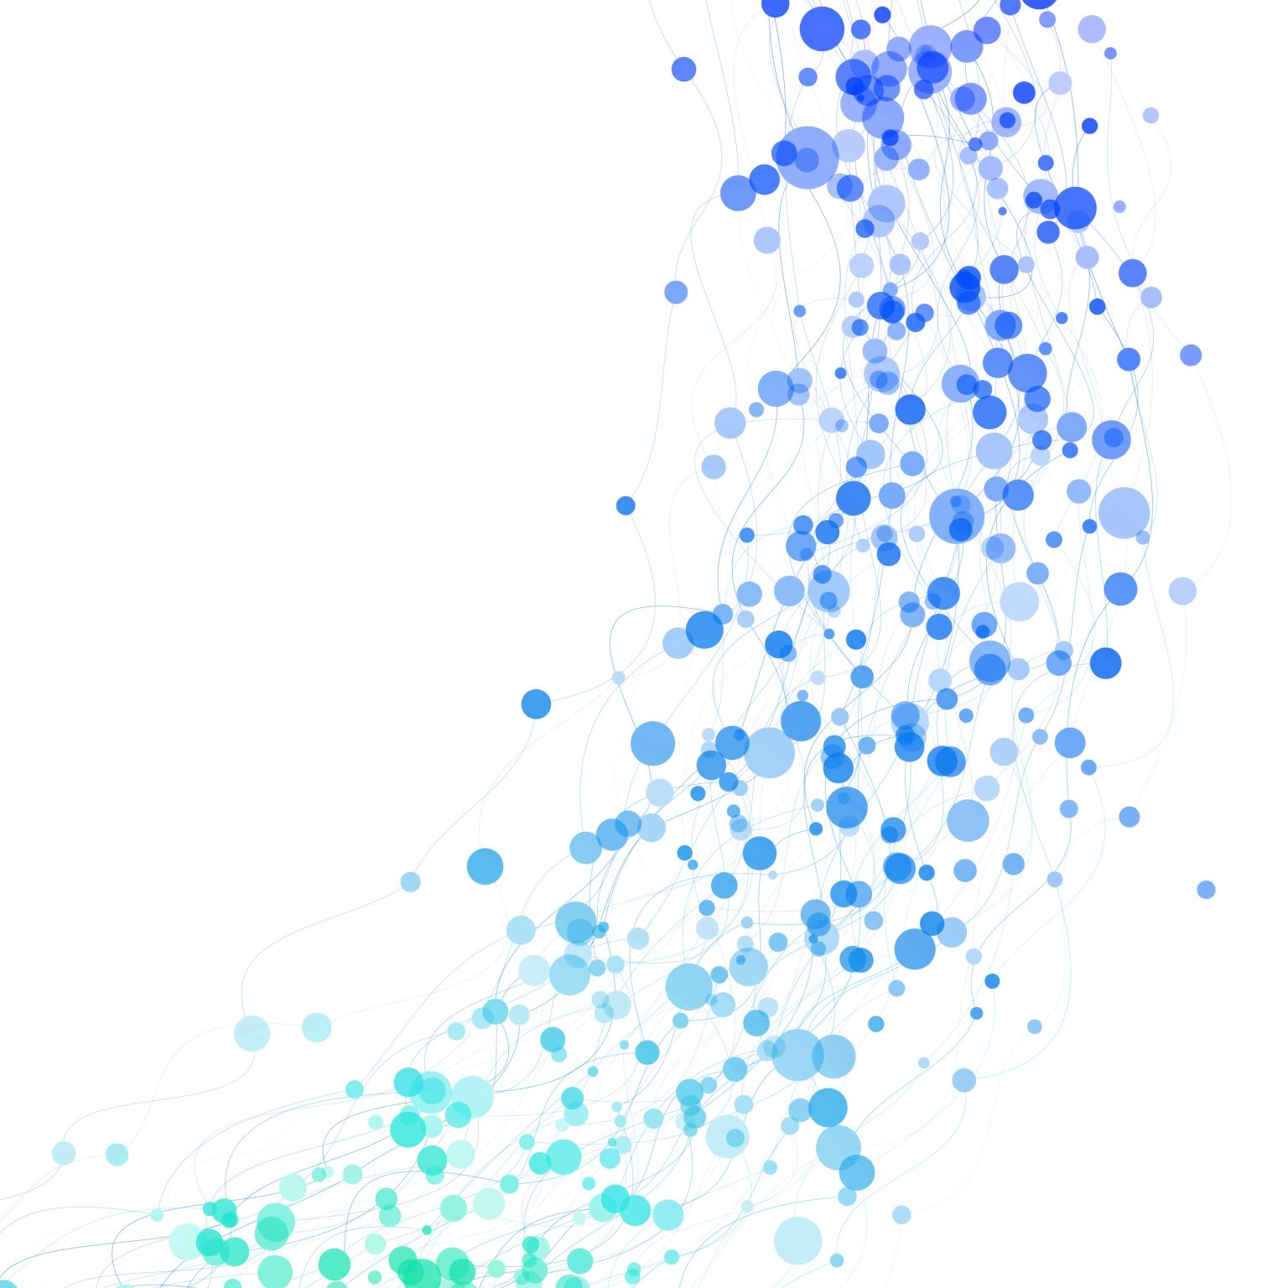

SKILLS SYNC Project
A Mentorship and Peer Collaboration Platform
makhosazana Dlomo

Slide 2

Overview:
SkillsSync is a Python-based application designed to facilitate mentorship and peer collaboration. It integrates Firebase for authentication and database management, Google Calendar for scheduling, and SMTP for email notifications. The platform allows users to book one-on-one or group sessions with mentors or peers, manage bookings, and receive real-time notifications.

Slide 3



KEY FEATURES

Slide 4
User Authentication & Management:
Secure user authentication using Firebase Authentication, including email/password sign-up, sign-in, and password reset functionality.
Role-based access control with two distinct roles: Mentor and Peer, each with tailored permissions and features.
Email verification to ensure user authenticity and security.
Session management to track active users, including their user ID, email, role, and login status, stored in Firebase Firestore.

Slide 5
Meeting Scheduling:
One-on-One or Group Sessions: Users can book individual sessions with mentors or peers, or organize group sessions for collaborative learning.
Google Calendar Integration: Seamless integration with Google Calendar to check mentor/peer availability, schedule meetings, and avoid conflicts.
Time Validation: Ensures meetings are scheduled only on weekdays (Monday to Friday) between 7:00 AM and 5:00 PM.
Rescheduling & Updates: Users can update or reschedule existing bookings, with automatic notifications sent to all attendees.
Conflict Detection: The system checks for conflicting events in Google Calendar and suggests alternative time slots if necessary.

Slide 6
Workshop Management:
Workshop Creation: Mentors can create workshops with details such as title, date, time, location, and description.
Workshop Updates & Cancellations: Mentors can modify or cancel workshops, with automated email notifications sent to all registered attendees.
Workshop Notifications: Attendees receive confirmation, reminder, and update emails for workshops they’ve signed up for.

Slide 7
Real-Time Notifications:
Email Notifications: Automated email notifications for meeting confirmations, updates, cancellations, and reminders using SMTP.
Customizable Notifications: Notifications are tailored based on the type of event (e.g., meeting confirmation, workshop update, etc.).
Attendee Communication: All attendees receive timely updates about changes to meetings or workshops, ensuring clear communication.

Slide 8
Feedback System:
Feedback Submission: Users can submit feedback on their mentorship or peer collaboration experience, including ratings and comments.
Feedback Storage: All feedback is securely stored in Firebase Firestore for future analysis and improvement.
Feedback Retrieval: Mentors and admins can view feedback to assess their performance and make data-driven improvements.

Slide 9
Search and Discovery
Mentor/Peer Search: Users can search for mentors or peers based on expertise, language, and availability.
Filtering Options: Advanced filtering allows users to find the most relevant mentors or peers for their needs.
Availability Display: Users can view the availability of mentors and peers, including their working hours and days.

Slide 10
Cleanup & Maintenance:
Automated Cleanup: A background process automatically removes expired meetings and workshops from the database to maintain efficiency.
Database Optimization: Regular cleanup ensures the Firestore database remains performant and free of outdated entries.

Slide 11
User-Friendly CLI Interface
Interactive Menus: A command-line interface (CLI) powered by the Click library provides an intuitive and interactive user experience.
Role-Based Menus: Different menus and options are displayed based on the user’s role (Mentor or Peer).
Pagination & Navigation: Users can easily navigate through lists of bookings, workshops, and search results with pagination support.

Slide 12
Security & Validation:
Input Validation: Ensures all user inputs (e.g., email, password, date, time) are validated before processing.
Authentication Checks: Users must be authenticated to access certain features, with session validation performed before critical actions.
Error Handling: Comprehensive error handling ensures users receive clear and actionable feedback in case of issues.

Slide 13
Extensibility & Scalability:
Modular Design: The application is built with modularity in mind, making it easy to add new features or extend existing ones.
Scalable Backend: Firebase Firestore and Google Calendar provide a scalable backend infrastructure capable of handling growing user demands.

